Slide 1
Excited Carrier Dynamics in Condensed Matter System
From ab initio simulation
Jin Zhao
University of Science and Technology of China

Slide 2
Back ground
Single particle dynamics
Spin dynamics
Exciton Dynamics
Outlook

Slide 3
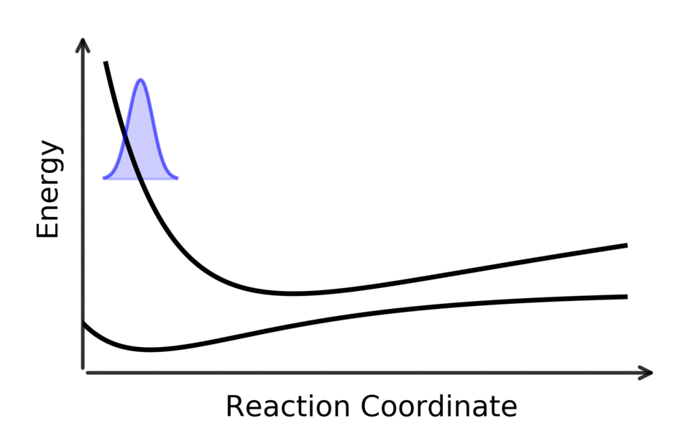
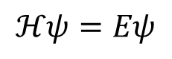
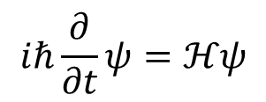
Carrier Dynamics in Condensed Matter Systems
Lattice
charge
orbital
spin
Condensed matter physics: Charge, spin and orbital
$$iℏ\frac{∂}{∂t}ψ=ℋψ$$
Important tool: First principles calculations
$$ℋψ=Eψ$$
Multi-dimension: energy, momentum, real space, spin, time

Slide 4
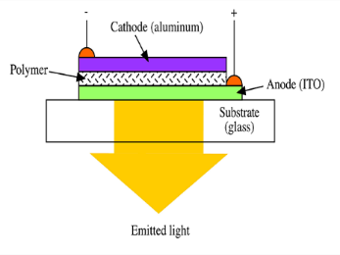
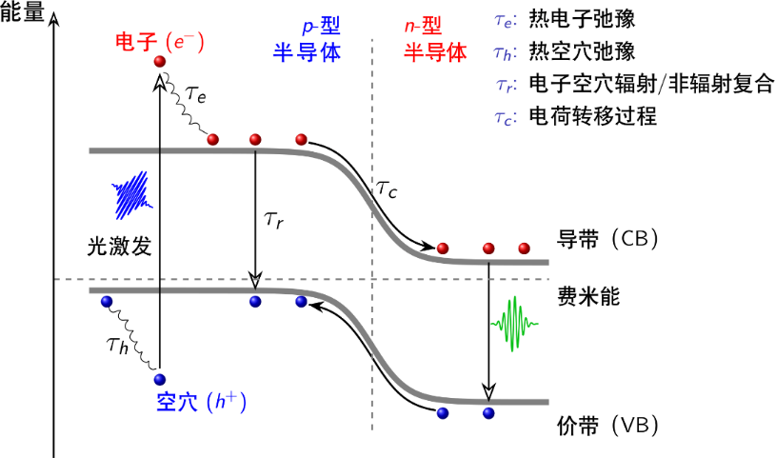
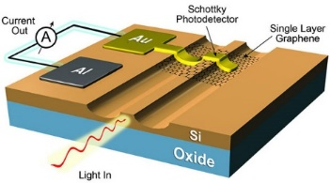
Applications of Photoexcited Carrier Dynamics
发光器件
长寿命
光探测器
中等寿命
光调制器
短寿命
太阳能电池各种载流子动力学行为共同决定效率
不同光电器件对材料载流子寿命有不同要求

Slide 5
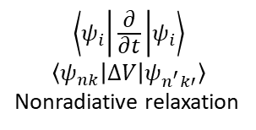
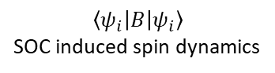
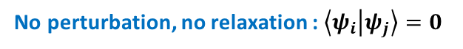
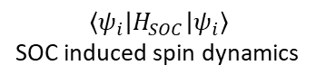
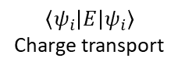
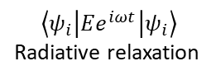
Determining Factors of Carrier Dynamics
No perturbation, no relaxation : $\left\langle ψ_{i} | ψ_{j}\right\rangle =0$
Many-body effects:
e-e interaction
e-h interaction (exciton effects)
spin-spin interaction
With perturbation：
$$\left\langle ψ_{i} | B | ψ_{i}\right\rangle$$
SOC induced spin dynamics
Electron / hole
Magnetic field
Spin-orbital coupling
Electric field
Photon
Phonon
Other effects:
Nuclear quantum effects
Potential energy surface of the excited state
$$\left\langle ψ_{i} | \frac{∂}{∂t} | ψ_{i}\right\rangle$$
$$\left\langle ψ_{nk} | ∆V | ψ_{n^{′}k′}\right\rangle$$
Nonradiative relaxation
$$\left\langle ψ_{i} | H_{SOC} | ψ_{i}\right\rangle$$
SOC induced spin dynamics
$$\left\langle ψ_{i} | Ee^{iωt} | ψ_{i}\right\rangle$$
Radiative relaxation
$$\left\langle ψ_{i} | E | ψ_{i}\right\rangle$$
Charge transport

Slide 6
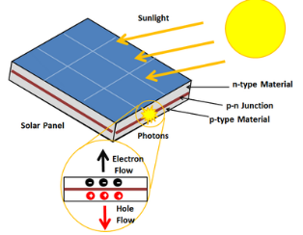
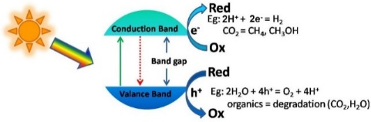
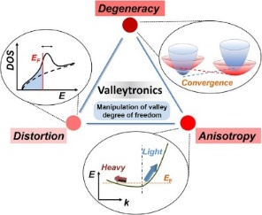
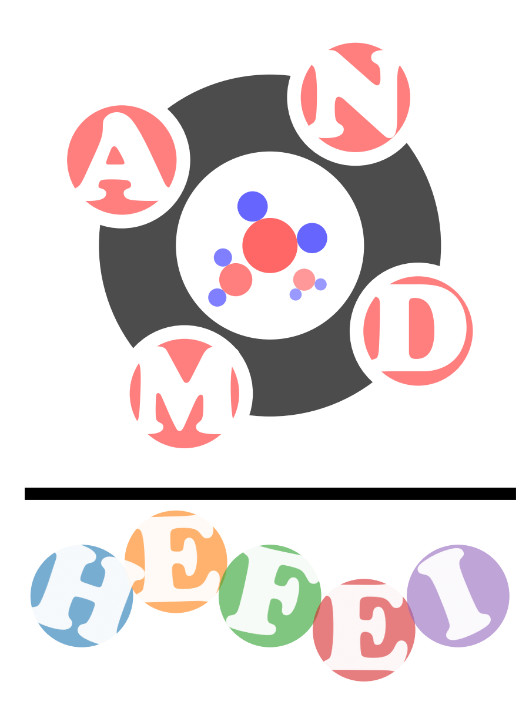
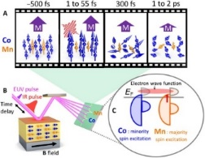
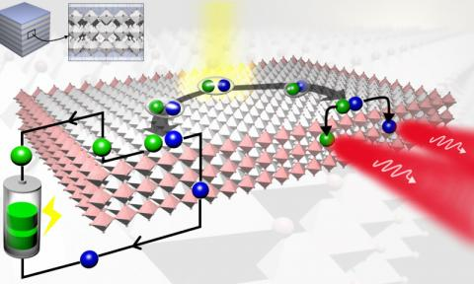
Ab initio Code for Excited Carrier Dynamics
Single Particle Dynamics
太阳能电池
光催化
谷电子学
Spin Dynamics
GW+rtBSE
光调控自旋动力学
光电器件

Slide 7
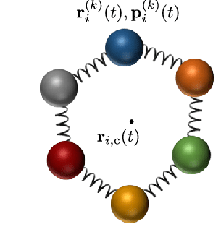
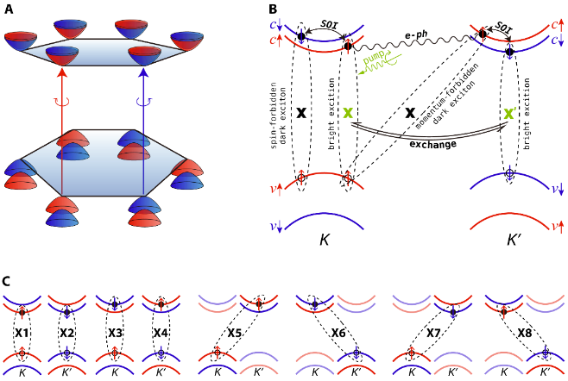
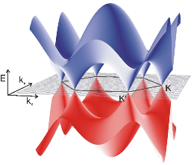
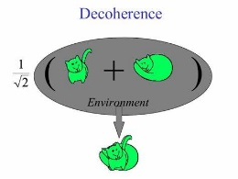
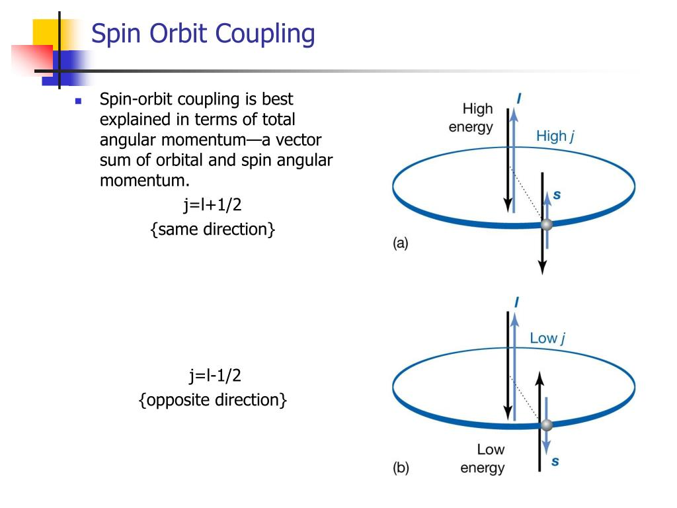
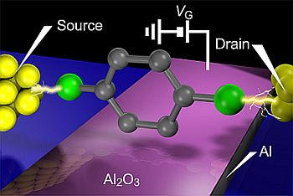
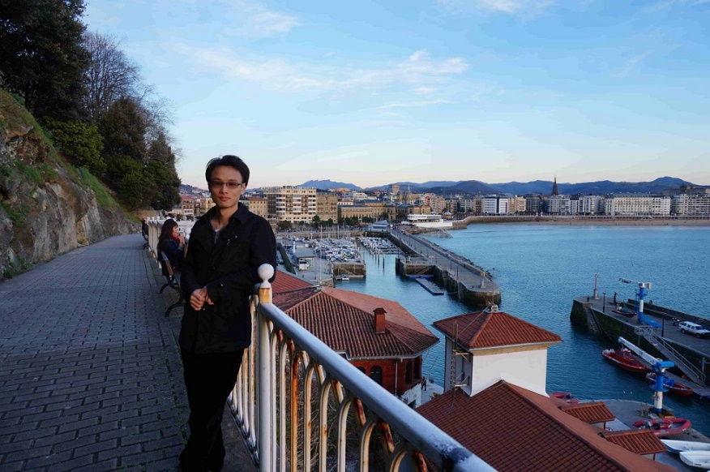
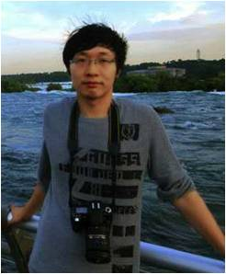
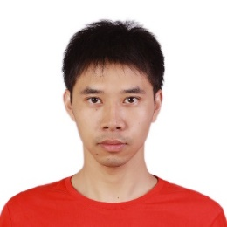
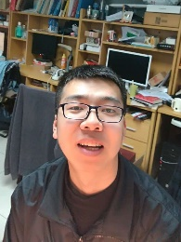


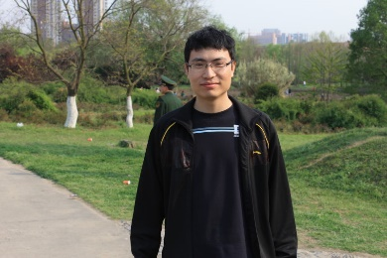
Quantum decoherence
Spin-orbital Coupling
Nuclear Quantum effects
GW + real-time BSE
Charge transport
Dynamics in momentum space
Hefei-NAMD
2016
2018
2018
2018
2021
now
now
郑奇靖
褚维斌
郑奇靖
褚维斌
蒋翔
田韫哲
郑镇法
赵传寓
史永亮

Slide 8
Back ground
Single particle dynamics
Spin dynamics
Exciton Dynamics
Outlook

Slide 9
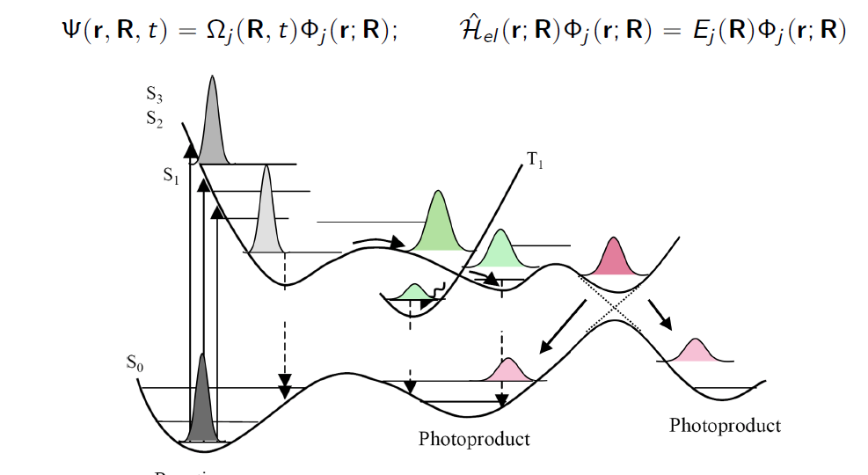
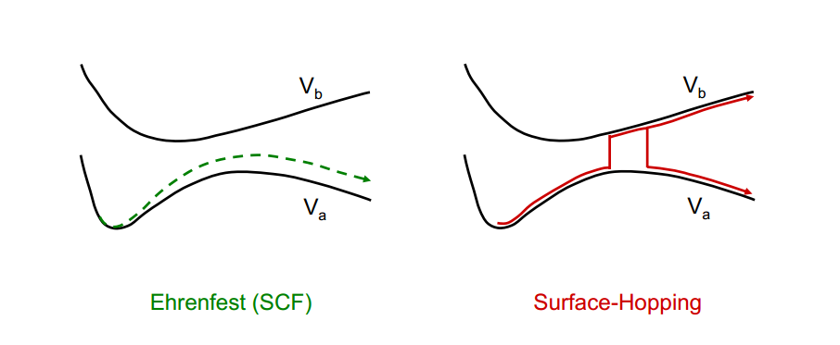
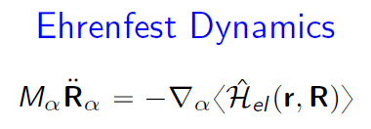
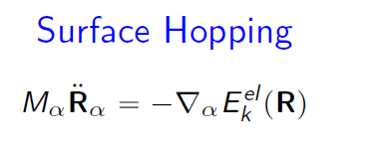
Beyond Born-Oppenheimer Approximation
Mixed Quantum-Classical approximation

Slide 10
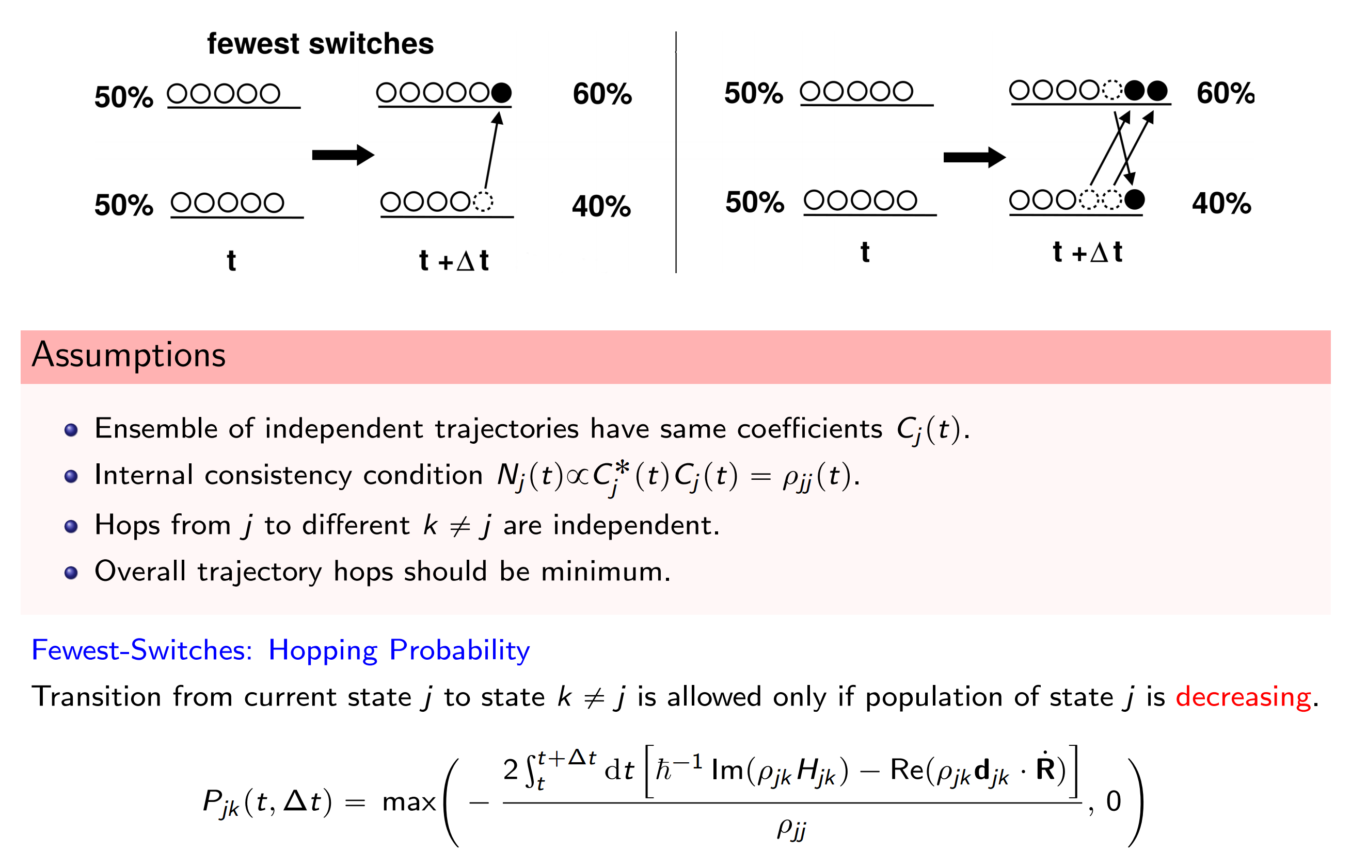
Fewest surface hopping

Slide 11
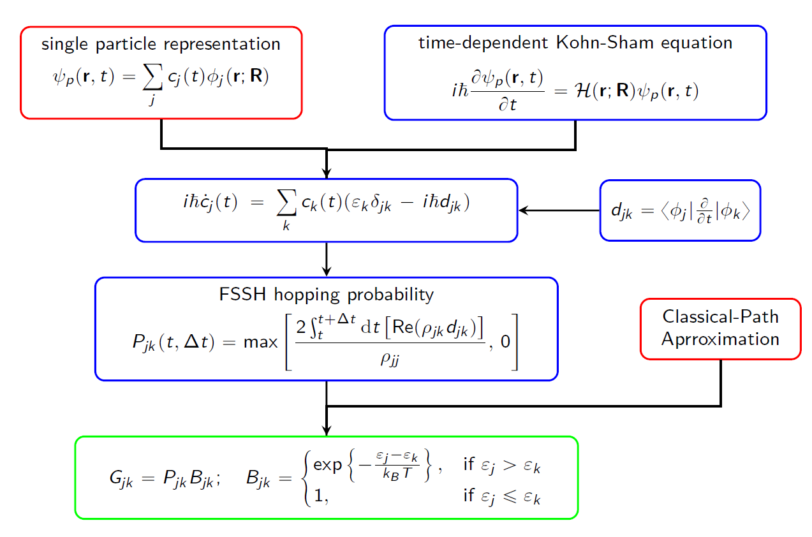
Surface Hopping Combined with TDKS
Nonadiabatic coupling (NAC)
A. Akimov and O. Prezhdo: Pyxaid
Q. Zheng, X. Jiang, et. al. J. Zhao: Hefei-NAMD

Slide 12
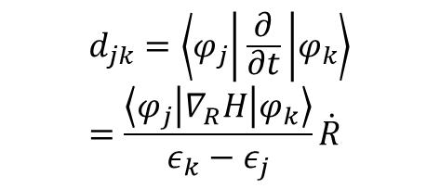

Electron-phonon interaction – Nonadiabatic coupling
$$H_{ki}=ε_{k}δ_{ik}−iℏ\left\langle k | \frac{∂}{∂t} | i\right\rangle$$
Nonadiabatic coupling
$$d_{jk}=\left\langle φ_{j} | \frac{∂}{∂t} | φ_{k}\right\rangle =\frac{\left\langle φ_{j} | ∇_{R}H | φ_{k}\right\rangle }{ε_{k}−ε_{j}}\dot{R}$$
Electron-phonon matrix elements
charge transfer dynamics
Electron-hole recombination

Slide 13
Electron-phonon interaction - Decoherence Correction

Slide 14
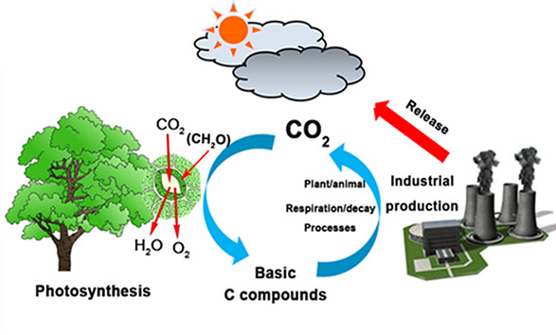
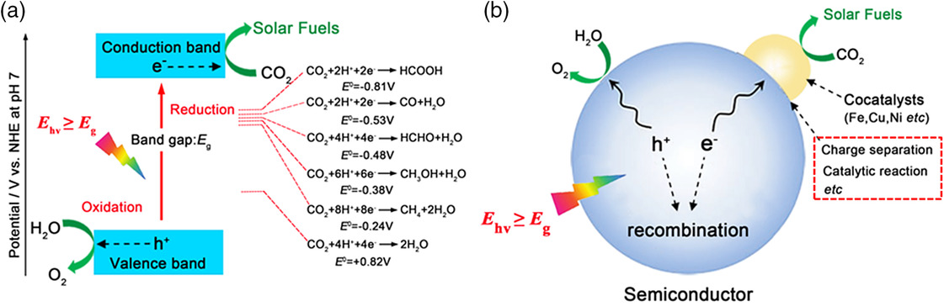
What is Photocatalysis
光解水
光还原CO₂
降解污染物
…
目标：通过第一性原理计算理解光催化反应机制，提出理论设计提升反应效率

Slide 15
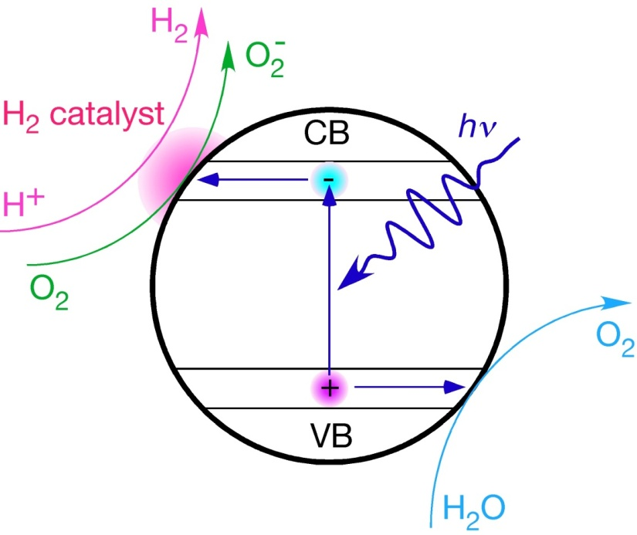
Crucial Processes in Photocatalysis on Surfaces
Photo-absorption
absorption spectra （DFT, GW+BSE)
Photoexcited carrier trapping
Lifetime of photoexcited carriers
Carrier migration to surface
Carrier trapping by molecules
Photochemical reaction on the surface
Excited state reaction barrier

Slide 16
Crucial Processes in Photocatalysis on Surfaces
Photo-absorption
absorption spectra （DFT, GW+BSE)
Photoexcited carrier trapping
Lifetime of photoexcited carriers
Carrier migration to surface
Carrier trapping by molecules
Photochemical reaction on the surface
Excited state reaction barrier
Excited Carrier Dynamics

Slide 17
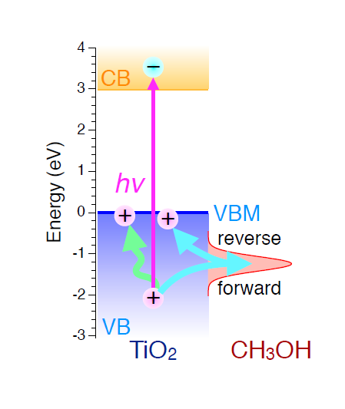
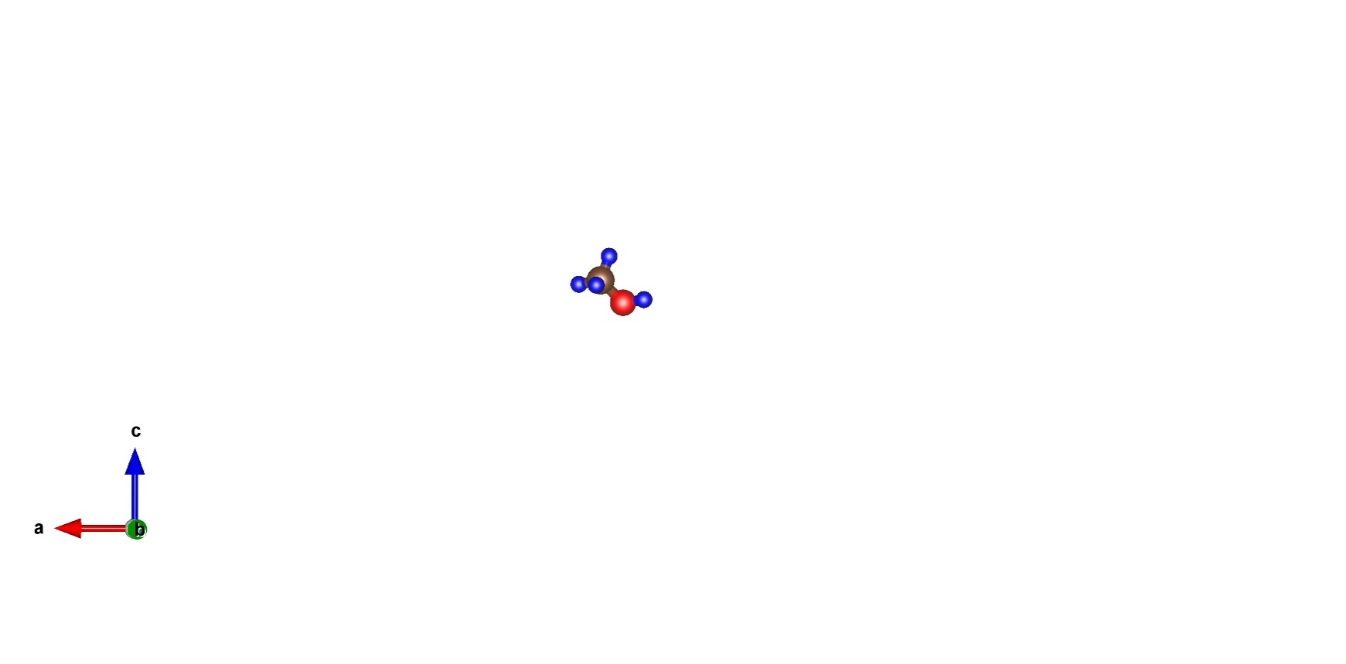
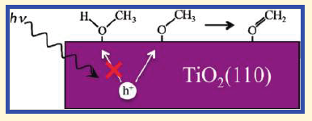
CH₃OH behaves as a hole scavenger on TiO₂
Hole induced dissociation of CH₃OH on TiO₂ observed by Bing Wang et.al.
Henderson et.al. believes that CH₃O is the hole trapper in stead of CH₃OH
M. Shen and M. A. Henderson, J. Phys. Chem. Lett. 2, 2707-2710 (2011)

Slide 18
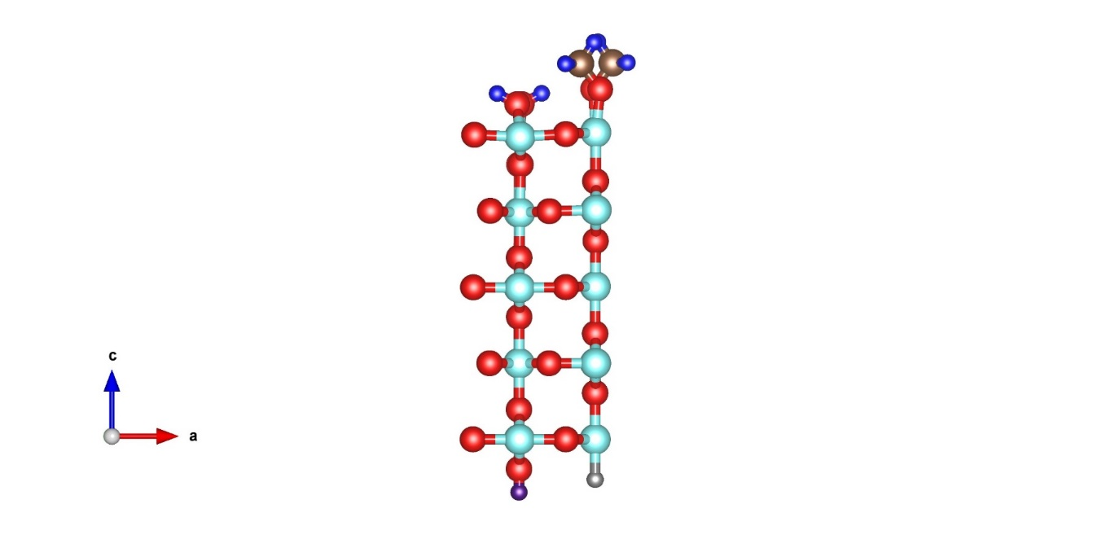
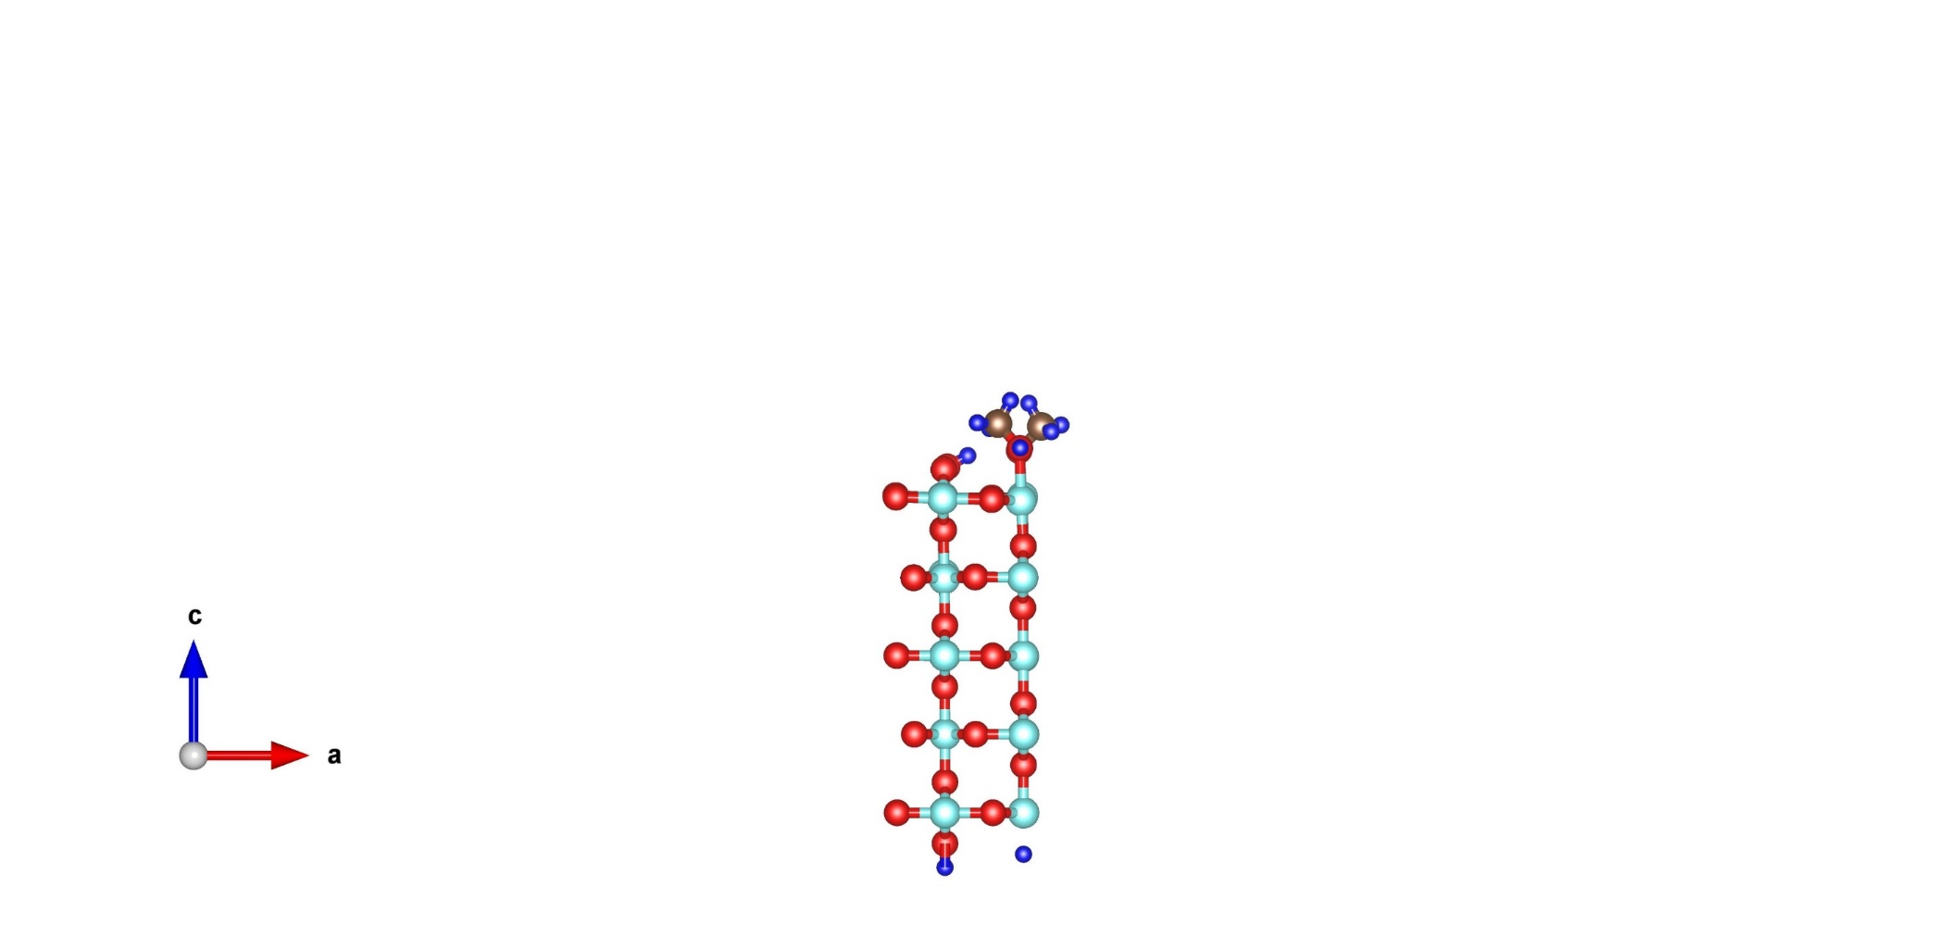

Hole trapping sites
M
HD
D
~30~50%
Hole transfer to HOMO (%)
~20~30%
~0.2%
Time (fs)
Average from 10⁵ trajactories

Slide 19
CH₃OH as a Hole Scavenger on TiO₂ Surface
W. Chu, W. A. Saidi, Q. Zheng*, Y. Xie, Z. Lan, O. V. Prezhdo, H. Petek and J. Zhao* J. Am. Chem. Soc, 138, 13740, (2016)

Slide 20
Nuclear Quantum Effects in NAMD
Mixed Quantum-Classical approximation
Ring-polymer molecular dynamics (RPMD)
Q: 如何在mixed quantum-classical approximation中考虑核量子效应
A: RPMD + NAMD

Slide 21
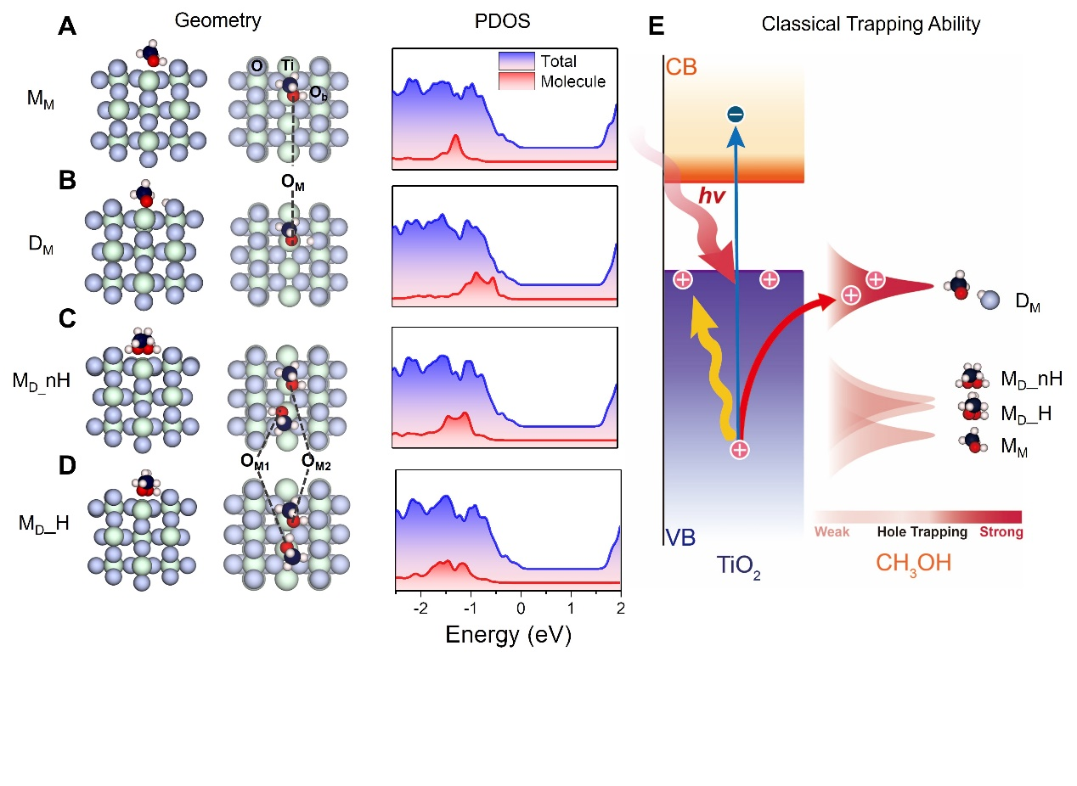
Different Adsorption Structures of CH₃OH on TiO₂
×
√
√
×
×
No H-bond network
×
×
×
H-bond network
Dissociated CH₃O (D_{M}) behaves as hole scavenger

Slide 22
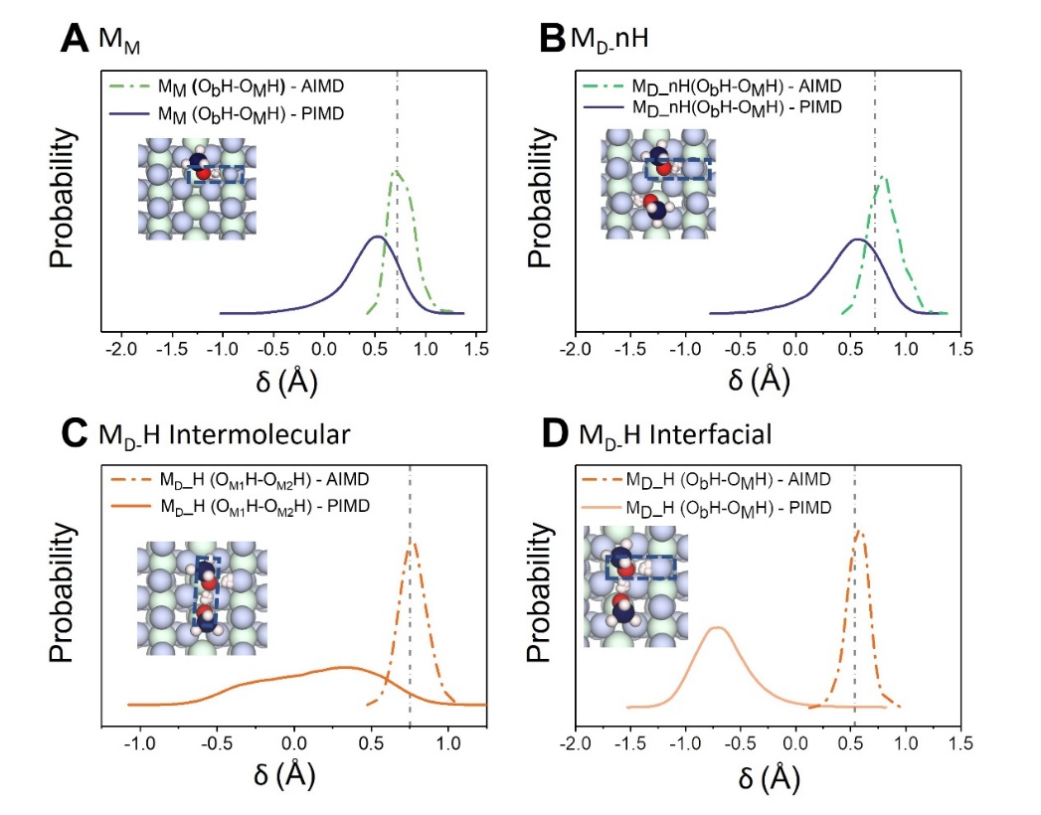
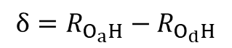
Nuclear Quantum effects (NQEs) on the Adsorption Structures
No H-bond network
$$δ=R_{O_{a}H}−R_{O_{d}H}$$
δ > 0 no proton transfer
δ < 0 proton tranfer
H-bond network
Quantum proton delocalization
NQEs induced proton transfer

Slide 23
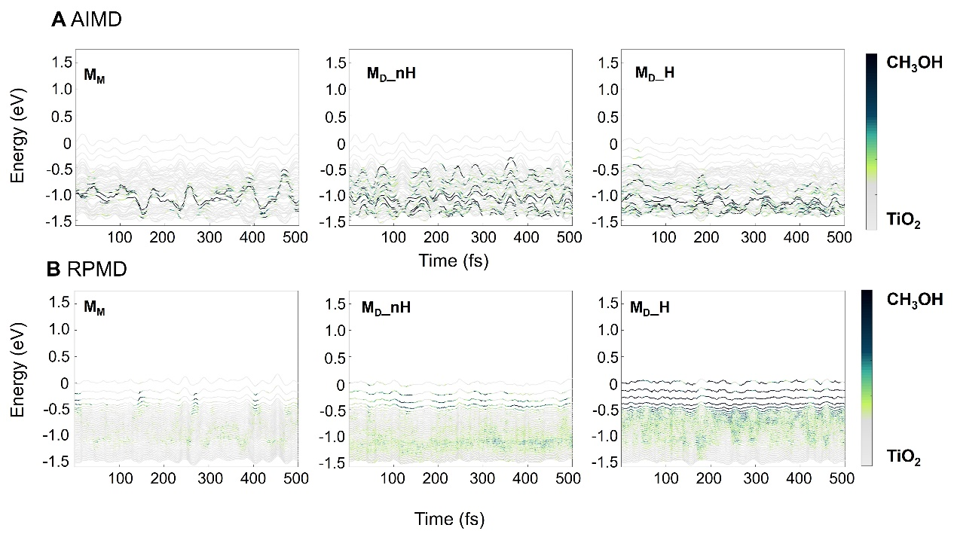
Nuclear Quantum effects on the Energy Level Alignment
VBM
VBM
H-bond network
NQEs change the band alignment of M_{D}_H system, where a H-bond network is formed.

Slide 24
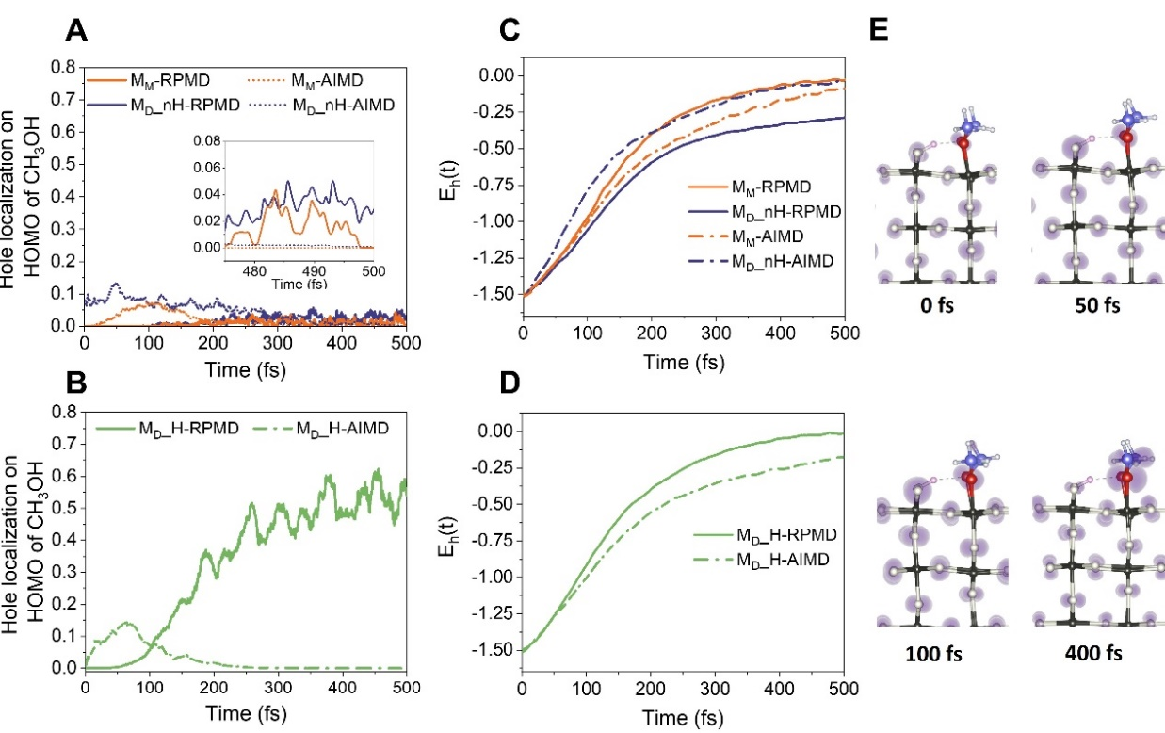
Nuclear Quantum Effects on Hole Trapping
×
√
×
√
NQEs makes M_{D}_H behave as a hole scavenger.

Slide 25
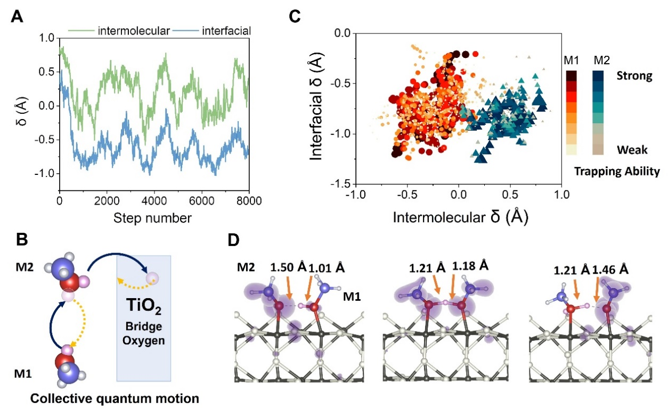
Collective Nuclear Quantum Motion Coupled Hole Transfer
In the H-bond network, the quantum proton motion is collective, which couples with hole trapping dynamics.

Slide 26

Experimental Evidence by STM
Dimer formation (H-bond network) improves the photochemical reaction rate.

Slide 27

Summary - Example I
W. Chu et al. X. Li*, J. Zhao* Sci. Adv. 8, eabo2675 (2022)

Slide 28


Outlook - Example I
M1,M2
M3,M4
M1
M2
RPMD/PIMD is very expensive!
Machine Learning + PIMD/RPMD

Slide 29

Outlook - Part II
光催化：
激发态势能面
势能面交叉
激发态载流子寿命
基态催化：
计算反应势垒，方法非常成熟

Slide 30
Back ground
Single particle dynamics
Spin dynamics
Exciton Dynamics
Outlook

Slide 31


Spin Dynamics
Spin-Orbital Interaction
Spin-Spin Interaction

Slide 32


Dynamics of Photogenerated Spin Hole Current
C. Zhao, et al. and J. Zhao*, Phys. Rev. B 96, 134308 (2017)
赵传寓
32

Slide 33
NAMD with SOC

Slide 34


Choices of Representations
郑奇靖

Slide 35

Ni金属自旋轨道耦合引发超快退磁过程
Spin up electrons will flip to Spin down electrons due to SOC
Spin down electrons will NOT flip to Spin up electrons due to SOC
They will decay to spin down electrons with lower energies.

Slide 36


自旋轨道耦合与电声耦合
$H_{ki}=ε_{k}δ_{ik}−iℏ\left\langle k | \frac{∂}{∂t} | i\right\rangle$ +$iℏ\left\langle k | ℋ^{SOC} | i\right\rangle$
In Ni, e-ph coupling > SOC. The electron tends to decay through the orbitals with the same spin.

Slide 37
Ni体系超快退磁
Z. Zheng, Q. Zheng*, J. Zhao*, Phys. Rev. B 105, 085142 (2022)

Slide 38


Excited Electron Dynamics in Bi₂Se₃
TSS@±S
Back scattering between TSS@+S and TSS@-S is forbidden
$$\left|+>\right.=𝒯\left|−>\right.$$
$$\left\langle + | U | −\right\rangle =0$$

Slide 39




Backscattering Between two TSS@±S Time-Reversal Partners
~ 100 fs
100 K
TSS@±S
CBM
TSS@±S
TSS@Γ
~ 20 ps
TSS@+S
TSS@-S
300 K
$$\left|+>\right.=𝒯\left|−>\right.$$
$$\left\langle + | U | −\right\rangle =0$$
$$\left|+,(t+Δt)>≠𝒯\left|−,t>\right.\right.$$
$\left\langle +,t | \left.−,(t+Δt\right)\right\rangle$ ≠ 0
Without phonon excitation
With phonon excitation

Slide 40

Excited State Spin Dynamics in Bi₂Se₃
Spin canting occurs in ~ 50 fs

Slide 41



Ultrafast Spin Relaxation of the Excited TSS Electron
N. Gedik* et al. Phys. Rev. Lett. 107, 077401 (2011)
C. Zhao, Q. Zheng*, J. Zhao*, Fundamental Research in press
Z. X. Shen* et al. Phys. Rev. Lett. 122, 167401 (2019)

Slide 42
Back ground
Single particle dynamics
Spin dynamics
Exciton Dynamics
Outlook

Slide 43

Excitons in 2D Materials
Exciton binding energy
A. Chernikov et al. Phys. Rev. Lett. 113 076802 (2014)
2D materials: quantum confinement significantly reduce the dielectric screening and increase the exciton binding energy

Slide 44

Failure of DFT
https://www.sas.upenn.edu/~jianmint/Research/
A. Morales-Garcia et al. J. Phys. Chem. C, 121, 18862 (2017)

Slide 45

GW + BSE to Describe the Exciton
GW: self-energy take place of exchange correlation potential
Accurate Quasi-particle energies
Bethe-Salpeter Equation (BSE): Screened Coulomb (W) and exchange (v) interaction of electron and hole
Exciton binding energy and wave function

Slide 46
Exciton Dynamics is Important
Exciton dynamics:
Exciton relaxation
Bright-to-dark transition
Single-to-multi transition
Singlet fission
Exciton annihilation (radiative and nonradiative)
…
10,000 times of GW+BSE calculations are too expensive!

Slide 47
Realization of GW + Real-Time BSE
From GW
BSE Hamiltonian:
Coulomb Interaction:
Exchange Interaction:
from time-dependent Kohn-Sham basis sets
Rigid dielectric function during MD
10,000 real-time GW + BSE – 1 GW + real-time BSE
QP energy: Rigid shift from KS energy

Slide 48


Realization of GW + Real-Time BSE
Single-particle
TDDFT
$$iℏ\frac{∂ψ(r,t)}{∂t}=𝓗\left(r;R\right)ψ\left(r,t\right)$$
Real-time - BSE
$$iℏ\frac{∂ψ(r_{e},r_{h,}t)}{∂t}=𝓗\left(r;R\right)ψ(r_{e},r_{h,}t)$$
Spin orbital coupling
two-particle
Many-body interaction：Coulomb and exchange
Exciton-phonon interaction：real-time BSE + molecular dynamics
Spin orbital coupling：adiabatic and diabatic representation
Nonadiabatic: surface hopping

Slide 49

含时激子动力学方法实现

Slide 50


Fast Intervalley Bright Exciton Scattering in Transition Metal Dichalcogenide
< 5 ps
K
K’
K
K’
Intervalley bright exciton scattering requires the spin flip and momentum transition of both electron and hole
Puzzle：how can such intervalley bright exciton happen within several picoseconds？

Slide 51

Test of the Dielectric Function Approximation
The dielectric function and GW QP correction almost does not change with the structure

Slide 52

Exciton Dynamics in MoS₂
~40 fs
Bright Exciton transition happens in several ps
~1 ps
~1 ps

Slide 53


Exchange Interaction Induced Bright Exciton Scattering
Nonadiabatic Coupling Elements：
Single particle dynamics：e-ph
Exciton dynamics: e-ph + W (e-h Coulomb) + v (e-h exchange) + SOC
Bright Exciton transition is induced by e-h exchange interaction

Slide 54

Single Particle Picture
Spin particle picture: photoexcited hole keeps in K valley

Slide 55




Summary
Single-particle
TDDFT
$$iℏ\frac{∂ψ(r,t)}{∂t}=𝓗\left(r;R\right)ψ\left(r,t\right)$$
Real-time - BSE
$$iℏ\frac{∂ψ(r_{e},r_{h,}t)}{∂t}=𝓗\left(r;R\right)ψ(r_{e},r_{h,}t)$$
two-particle
Many-body interaction
Exciton-phonon interaction
Spin orbital coupling
Nonadiabatic effects
X. Jiang, Q. Zheng, Z. Lan, W. A. Saidi, X. Ren and J. Zhao* Sci. Adv. , 7, eabf3759, (2021)
Xiang Jiang
蒋翔

Slide 56



Slide 57
Back ground
Single particle dynamics
Spin dynamics
Exciton Dynamics
Outlook

Slide 58

What can be Done Using the GW-rtBSE NAMD Simulation
Exciton Lifetime
Hot exciton Relaxation
Exciton transition
at interface
via spin valley
bright-to-dark
…
Exciton-Phonon Interaction
Exciton-Polaron interaction
Excited state potential surface from machine learning
Several thousands of exciton energies can be used for machine learning
Photo-induced phase transition
Photocatalysis

Slide 59

NAMD Simulation in Momentum Space

Slide 60

Phonon Excitation

Slide 61

Hefei-NAMD的应用与推广
Publications by Hefei-NAMD（over 80）
Journal | Number of Publications
Sci. Adv. | 3
Nat. Commun. | 1
Phys. Rev. Lett. | 3
JACS | 2
Adv. Mater. | 1
Nano Lett. | 4
ACS NANO | 1
J. Phys. Chem. Lett. | 18
Chem. Sci. | 1
Angew Chem. | 1

Slide 62





大连理工大学高峻峰
电子科大周柳江
南京理工大学陆瑞峰

Slide 63
Reference & Developers
Video
Hefei-NAMD使用的一些经验
https://www.koushare.com/video/videodetail/11720
Hefei-NAMD基本流程介绍
https://www.bilibili.com/video/BV1p5411c7RS
Hefei-NAMD培训
https://www.koushare.com/lives/room/341102
Website:
http://staff.ustc.edu.cn/~zqj
http://staff.ustc.edu.cn/~zhaojin
https://github.com/QijingZheng
https://github.com/WeibinChu
Developers:
Dr. Qijing Zheng (郑奇靖), zqj@ustc.edu.cn
Mr. Xiang Jiang (蒋翔), jxiang@mail.ustc.edu.cn, exciton dynamics
Dr. Weibin Chu (褚维斌), wbchu@ustc.edu.cn, CA-NAC, DISH
Dr. Chuanyu Zhao (赵传寓), zhaochuanyu@zju.edu.cn, DISH
Mr. Zhenfa Zheng (郑镇法), zzfgjs@mail.ustc.edu.cn, Dynamics in momentum space

Slide 64




Determining Factors of Carrier Dynamics
No perturbation, no relaxation : $\left\langle ψ_{i} | ψ_{j}\right\rangle =0$
Many-body effects:
e-e interaction
e-h interaction (exciton effects)
spin-spin interaction
With perturbation：
$$\left\langle ψ_{i} | B | ψ_{i}\right\rangle$$
Magnetic field induced spin dynamics
Electron / hole
Magnetic field
Spin-orbital coupling
Electric field
Photon
Phonon
Other effects:
Nuclear quantum effects
Potential energy surface of the excited state
$$\left\langle ψ_{i} | \frac{∂}{∂t} | ψ_{i}\right\rangle$$
$$\left\langle ψ_{nk} | ∆V | ψ_{n^{′}k′}\right\rangle$$
Nonradiative relaxation
$$\left\langle ψ_{i} | H_{SOC} | ψ_{i}\right\rangle$$
SOC induced spin dynamics
$$\left\langle ψ_{i} | Ee^{iωt} | ψ_{i}\right\rangle$$
Radiative relaxation
$$\left\langle ψ_{i} | E | ψ_{i}\right\rangle$$
Charge transport

Slide 65












郑奇靖
中科大副教授
褚维斌
复旦大学青年研究员
蒋翔
UC Irvine 博后
郑镇法
博士生
史永亮
华为
张丽丽
郑州大学讲师
赵传寓
腾讯
兰峥岗
华南师大
Surface hopping
李新征
北京大学
PIMD
任新国
中科院物理所
GW+BSE
谭世倞
中科大
实验
王兵
中科大
实验
Hrvoje Petek
匹兹堡大学
实验
杨金龙
中科大
讨论+支持
感谢基金委、科技部、中国科大的经费支持

